Slide 1
Predicting the Severity of Road Traffic Accidents UMBC Data Science Master Degree Capstone by Dr. Chaojie (Jay) Wang
Author Name: Divya Aitipamula
Student ID: YK91210
Github
LinkedIn

Slide 2
Project Overview
Aim: To predict the severity of road traffic accidents using machine learning techniques.
What is it About? The project focuses on predicting the severity of road traffic accidents, which are a major cause of injury and death worldwide. By leveraging data-driven methods, we aim to understand the key factors contributing to the severity of these accidents—categorized as fatal, serious, or slight and build predictive models to anticipate future accident severity.

Slide 3
Problem Statement
Context: Accurately predicting the severity of road traffic accidents is challenging due to the complexity of factors involved, such as environmental conditions, vehicle types, and driver demographics.
Objective: To develop a robust predictive model to forecast accident severity, helping in better preparedness and resource allocation.

Slide 4

Research Questions?
What are the most significant factors influencing the severity of road traffic accidents?
How accurately can machine learning models predict the severity of road traffic accidents?
Which combinations of factors (e.g., environmental conditions, vehicle types, driver demographics) are most strongly associated with severe accidents?

Slide 5
Dataset Overview
Data Sources: The dataset used for this project is obtained from the UK Department for Transport's road casualty statistics. It provides detailed information on road traffic accidents and casualties for the year 2022. This publicly available dataset contains various attributes related to accident circumstances, vehicle details, and casualty information.
UK Department for Transport's Road Casualty Statistics
Kaggle Dataset
Data Size: 5MB
Data Shape: 61,352rows and 20 columns.
Time period: 2022

Slide 6
Data Dictionary Each row in the dataset represents a single casualty occurrence in a road traffic accident for the year 2022. This means that every entry corresponds to an individual involved in an accident, including their details, the accident circumstances, and the severity of their injuries.
Column Name | Data Type | Definition | Potential Values
Status | String | The status of the accident (e.g., reported, under investigation). | "Reported", "Under Investigation", etc.
Accident_Index | String | A unique identifier for each reported accident. | Alphanumeric string (e.g., "2022070151244")
Accident_Year | Integer | The year in which the accident occurred. | Year (e.g., 2022)
Accident_Reference | String | A reference number associated with the accident. | Alphanumeric string
Vehicle_Reference | Integer | A reference number for the involved vehicle in the accident. | Integer (e.g., 1, 2, 3, etc.)
Casualty_Reference | Integer | A reference number for the casualty involved in the accident. | Integer (e.g., 1, 2, 3, etc.)
Casualty_Class | Integer | Indicates the class of the casualty (e.g., driver, passenger, pedestrian). | 1 = Driver/Rider, 2 = Passenger, 3 = Pedestrian
Sex_of_Casualty | Integer | The gender of the casualty. | 1 = Male, 2 = Female, -1 = Unknown
Age_of_Casualty | Integer | The age of the casualty. | Range from 0 to 100+, -1 = Unknown

Slide 7
Contd..
Column Name | Data Type | Definition | Potential Values
Age_Band_of_Casualty | Integer | Age group to which the casualty belongs. | 1 = 0-5, 2 = 6-10, 3 = 11-15, ..., 11 = 95+
Casualty_Severity | Integer | The severity of the casualty's injuries. | 1 = Fatal, 2 = Serious, 3 = Slight
Pedestrian_Location | Integer | The location of the pedestrian at the time of the accident. | 0 = Not a Pedestrian, 1 = Crossing on Pedestrian Crossing, ..., 5 = In Carriageway
Pedestrian_Movement | Integer | The movement of the pedestrian during the accident. | 0 = Not a Pedestrian, 1 = Crossing from Nearside, 2 = Crossing from Offside, etc.
Car_Passenger | Integer | Indicates whether the casualty was a car passenger at the time of the accident. | 0 = No, 1 = Yes
Bus_or_Coach_Passenger | Integer | Indicates whether the casualty was a bus or coach passenger. | 0 = No, 1 = Yes
Pedestrian_Road_Maintenance_Worker | Integer | Indicates whether the casualty was a road maintenance worker. | 0 = No, 1 = Yes
Casualty_Type | Integer | The type of casualty (e.g., driver/rider, passenger, pedestrian). | 1 = Driver/Rider, 2 = Passenger, 3 = Pedestrian, etc.
Casualty_Home_Area_Type | Integer | The type of area in which the casualty resides (e.g., urban, rural). | 1 = Urban, 2 = Small Town, 3 = Rural
Casualty_IMD_Decile | Integer | The IMD decile of the area where the casualty resides (a measure of deprivation). | 1 (most deprived) to 10 (least deprived), -1 = Unknown
LSOA_of_Casualty | String | The Lower Layer Super Output Area (LSOA) associated with the casualty's location. | Alphanumeric code (e.g., "E01033378")

Slide 8
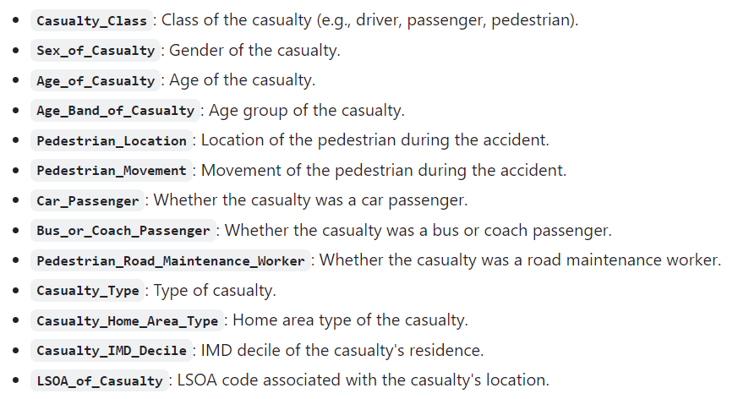
Selected Features/Predictors for the ML Models
These features are selected to train the ML models by capturing diverse aspects that could influence the severity of accidents, from demographic details to specific circumstances of the accident.
Target Variable:
Casualty_Severity column is the target variable in the machine learning model. It represents the severity of the accident and is categorized into three levels: 1 = Fatal, 2 = Serious, 3 = Slight.

Slide 9
Exploratory Data Analysis (EDA)
Data Cleansing and Preprocessing:
Target Variable: Focused on casualty_severity to predict accident severity.
Feature Selection: Retained relevant features; removed irrelevant columns to streamline analysis.
Summary Statistics: Generated for key variables to understand data distribution, central tendencies, and spread, providing insights into feature characteristics and the overall dataset.
Data Quality Checks:
Missing Values: No missing values detected, ensuring dataset completeness.
Duplicate Rows: Checked for duplicates; none found, confirming data integrity

Slide 10
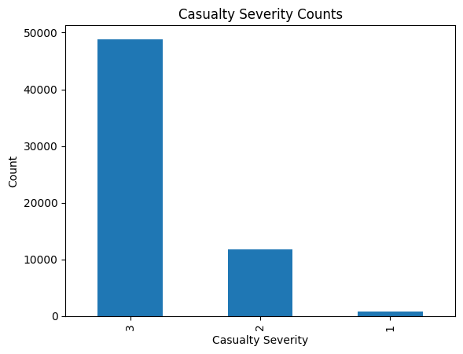
Data Visualization:
Univariate Analysis:
Analyzed the distribution of casualty_severity using the value_counts() function to determine the frequency of each severity level (Fatal, Serious, Slight).
Generated a bar plot with severity levels on the x-axis and their corresponding frequencies on the y-axis to illustrate the dataset's balance.

Slide 11
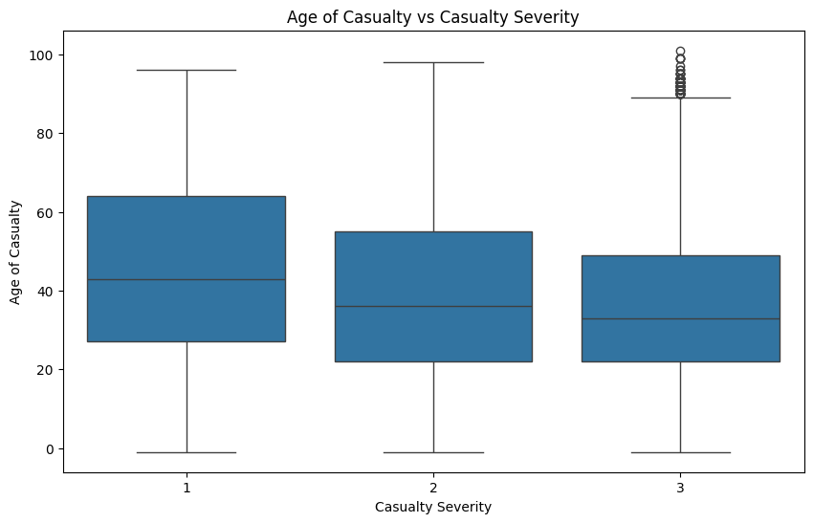
Bivariate Analysis:
Utilized a boxplot to examine the correlation between `casualty_severity` and `age_of_casualty`, with severity levels on the x-axis and ages on the y-axis.
Identified specific age groups more susceptible to severe injuries, suggesting the need for targeted safety interventions.

Slide 12
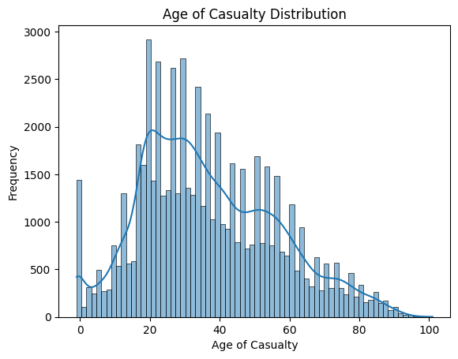
Visualizing the Data:
Age Distribution Analysis: Created a histogram with a Kernel Density Estimate (KDE) curve to visualize the distribution of age_of_casualty, identifying age groups most frequently involved in accidents.
Pattern Detection: The KDE curve offered a smoothed perspective, highlighting trends that could impact model performance.

Slide 13
Model Training, Evaluation, and Hypertuning
Selected Models for Predictive Analytics
Random Forest Classifier
Logistic Regression
K-Nearest Neighbors (KNN)
Gradient Boosting Classifier
Training Methodology
Data Splitting: 80% training, 20% testing to ensure model generalization.
Python Packages:
- `scikit-learn` for model operations.
- `pandas` and `NumPy` for data manipulation.
- `Matplotlib` and `Seaborn` for visualization.
Development Environment: Google Colab for computation; GitHub for version control.

Slide 14
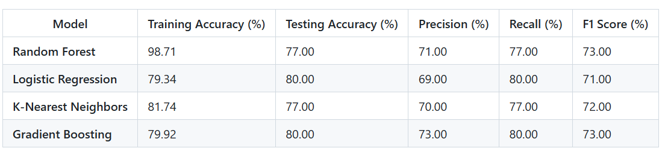
Initial Model Evaluation (Pre-Tuning)
The table below presents the training and testing accuracies, along with precision, recall, and F1 scores for each model evaluated initially, before tuning.
For the Random Forest, Logistic Regression, K-Nearest Neighbors (KNN, Gradient Boosting

Slide 15
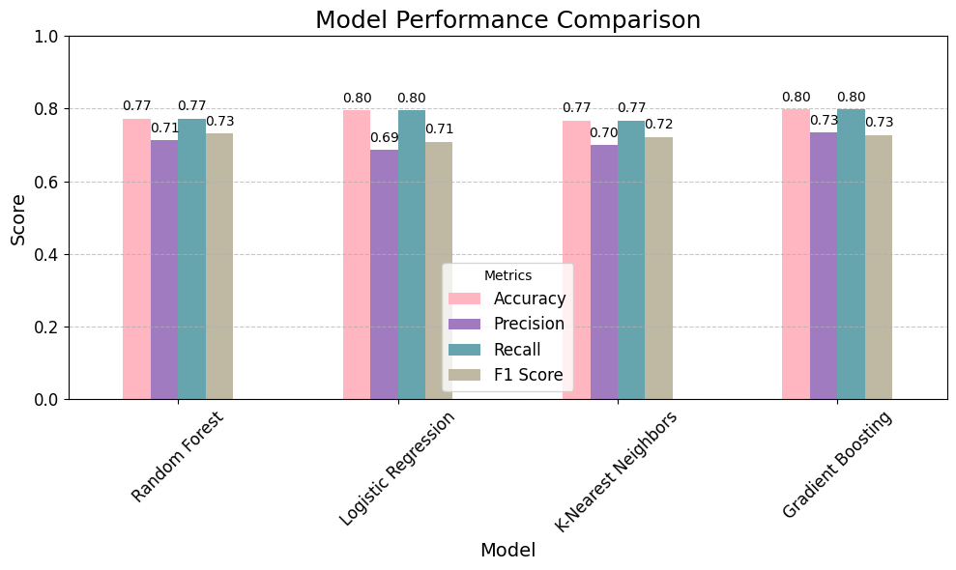

Slide 16
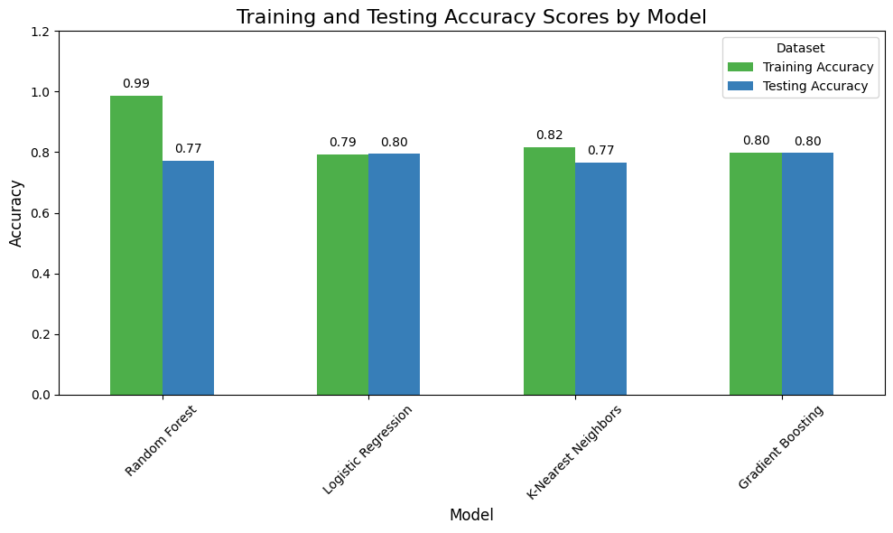
Observations on Overfitting
Random Forest: High training accuracy (98.71%) but lower testing accuracy (77%) indicates overfitting.
Logistic Regression: Balanced performance with training accuracy at 79.34% and testing at 80%, suggesting good generalization.
K-Nearest Neighbors (KNN): Training accuracy of 81.74% and testing at 77% show slight overfitting.
Gradient Boosting: Consistent accuracies with 79.92% on training and 80% on testing datasets, indicating strong generalization.

Slide 17
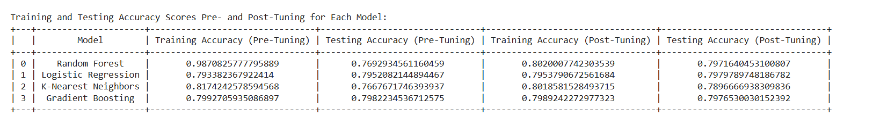
Hypertuning with RandomizedSearchCV
Hyperparameter tuning was conducted using RandomizedSearchCV to enhance model performance and generalization. The table below outlines the parameter grids and optimal configurations for each model.
Model Evaluation - Post-Tuning Results
Post-tuning, the models demonstrated improved accuracy and generalization, as detailed below:

Slide 18
Observations on Tuning Results
Random Forest: Reduced overfitting; training accuracy lowered to 80.28%, testing improved to 79.69%.
Logistic Regression: Testing accuracy increased slightly to 79.79%, showing balanced and stable performance.
K-Nearest Neighbors (KNN): Improved generalization; testing accuracy rose to 78.96%.
Gradient Boosting: Consistent stability; testing accuracy around 79.76%.
Best Model Selection: Logistic Regression selected for its balanced performance, achieving 79.79% testing accuracy.

Slide 19
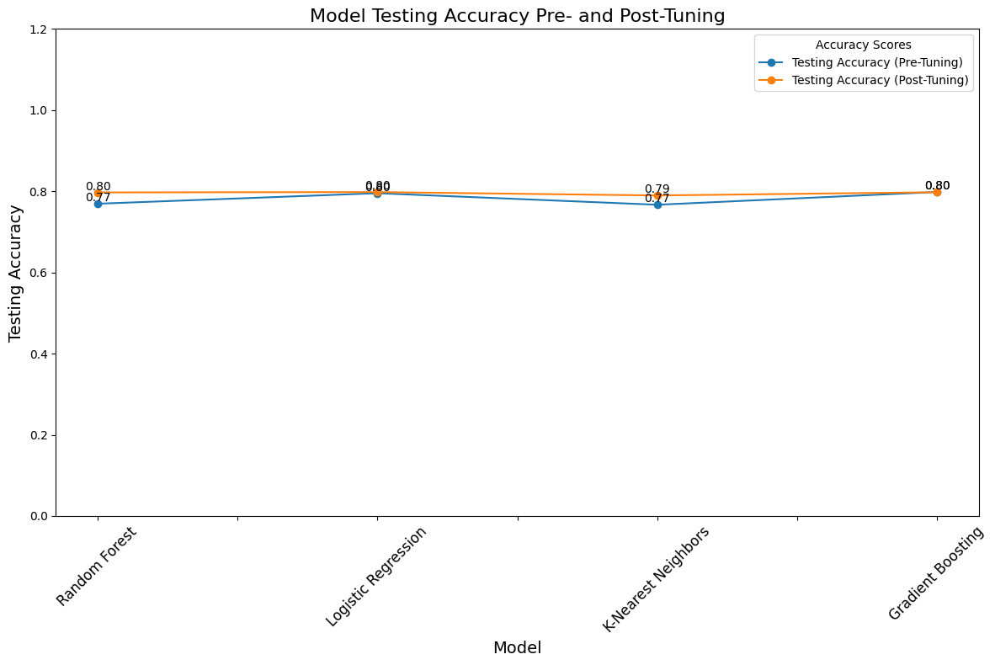

Slide 20
Web Application Development
A user-friendly web application was built using Streamlit to make the model accessible and interactive. Key features include:
User Input: Fields for entering accident details, such as casualty class, age, pedestrian location, and other selected features.
Prediction Output: After processing the input data, the app displays the predicted accident severity, helping users understand potential risk levels.

Slide 21
Conclusion:
Summary of Findings
The project successfully demonstrated the predictive capabilities of machine learning models in assessing road traffic accident severity. Logistic Regression emerged as the best model, providing actionable insights for emergency response, insurance assessment, and urban planning.
Potential Applications
Traffic Safety: Insights from the model can help policymakers implement safety measures in high-risk areas.
Insurance: The model enables insurers to assess accident severity, leading to fairer premiums.
Emergency Response: Predicting severity supports optimized resource allocation in emergencies, potentially saving lives.

Slide 22
Limitations and Future Directions
Data Scope: Expanding the dataset across more regions and years could improve model applicability.
Additional Features: Incorporating external factors, such as weather conditions and traffic density, may enhance prediction accuracy.
Advanced Models: Future research could explore deep learning models to potentially improve predictive capabilities.
References:
UK Department for Transport's Road Casualty Statistics
Kaggle Dataset

Slide 23
"Thank you all for your time and attention”.

